Slide 1

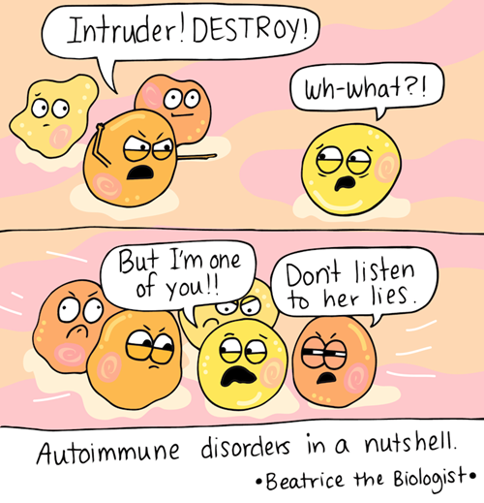
In silico analysis of host-pathogen interaction: a case study with molecular mimicry phenomena
Supervisor:
Dr. Manish Kumar
Presented by:
Anjali Garg

Slide 2
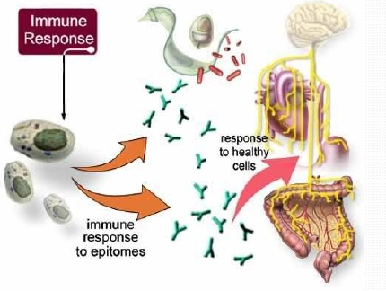
What is autoimmunity?
Autoimmunity is a condition in which immune system mistakenly recognize self as foreign, and attack them to destroy.
Example: Long list of pathological conditions. The most common are
Rheumatoid arthritis, multiple sclerosis, type 1 diabetes.
AUTOIMMUNE DISEASES are multifactorial.

Slide 3
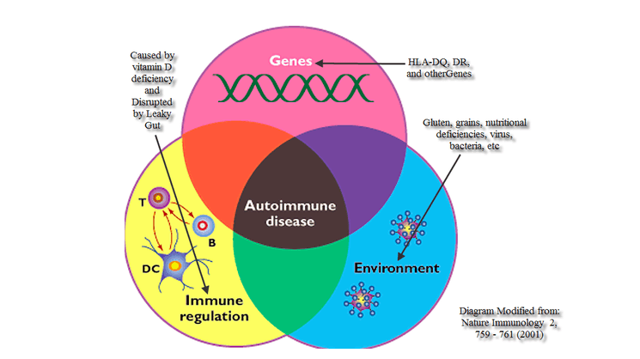
Factors that may trigger an Autoimmune disease
Genetics
Toxicity
Hormonal changes
Stress
Food sensitivities
Viral/Bacterial infections
Poor Gut Health
Inflammation

Slide 4
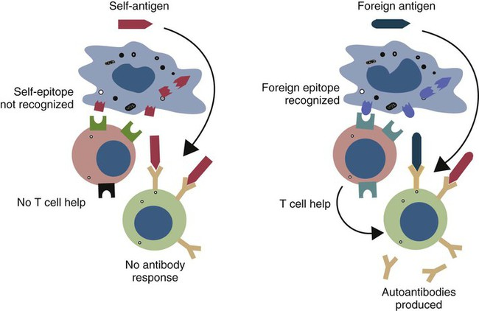
Mimicry all the way down
Several pathogenic microorganisms are known to produce proteins that mimic the form and functions of host proteins to exploit cellular machinery and counter immune defences.
Activate T and B cells, producing cross-reactive autoantibodies.
Molecular mimics have been identified to subvert all major cellular processes — including cell-cycle progression, membrane trafficking, cytoskeleton dynamics and signal transduction — to promote infections.

Slide 5
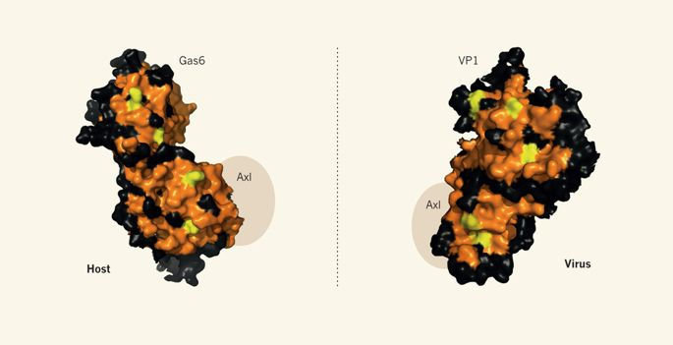
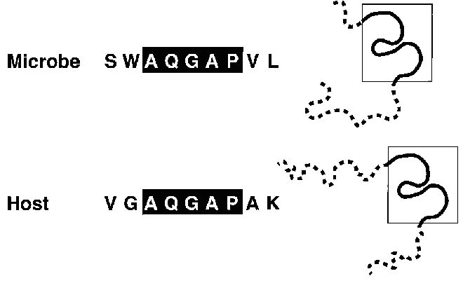
In molecular mimicry either the molecules’ linear amino acid sequences or their conformational fits may be shared, even though their origins are different.
Close enough in homology (between self and microbe) to share determinants.
Distant enough from homology to be recognized as foreign by the immune system.
Homology at self determinant (epitope) having important biological activity.
Example:
Surface protein of the simian virus SV40 i.e. VP1 (Right) mimics the ligand protein Gas6 (left) of the receptor Axl

Slide 6
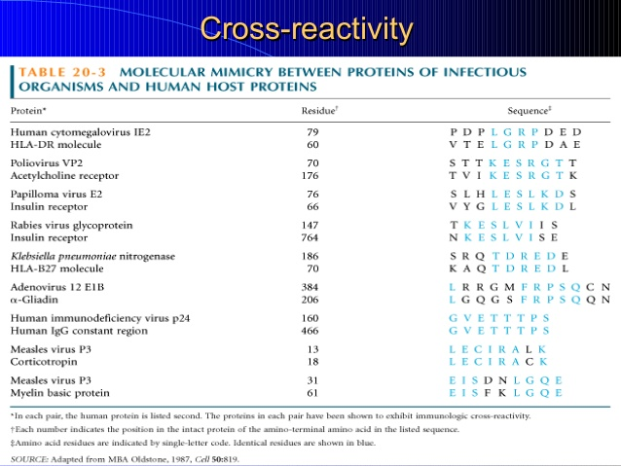
Example of molecular mimicry

Slide 7
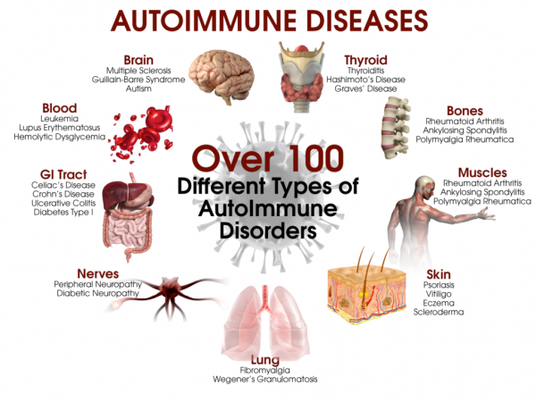
Autoimmune Diseases

Slide 8
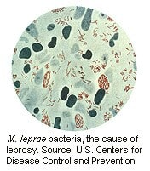
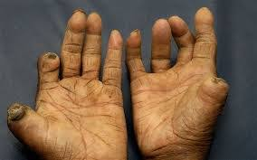
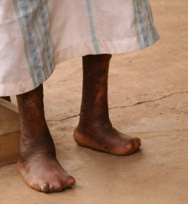
The most recognized and dreaded Autoimmune Disease ? In Fact it’s Leprosy !
Leprosy is a slowly developing, progressive disease that damages the skin and nervous system.
Leprosy is caused by an infection with Mycobacterium leprae or M. lepromatosis bacteria.
Early symptoms begin in cooler areas of the body and include loss of sensation.
Signs of leprosy are painless ulcers, skin lesions of hypo-pigmented macules (flat, pale areas of skin), and eye damage (dryness, reduced blinking). Later, large ulcerations, loss of digits, skin nodules, and facial disfigurement may develop.
Symptoms
Human
M. leprae
Myelin basic protein (MBP)
50S ribosomal L2 and
lysyl tRNA synthetase
B-cell

Slide 9
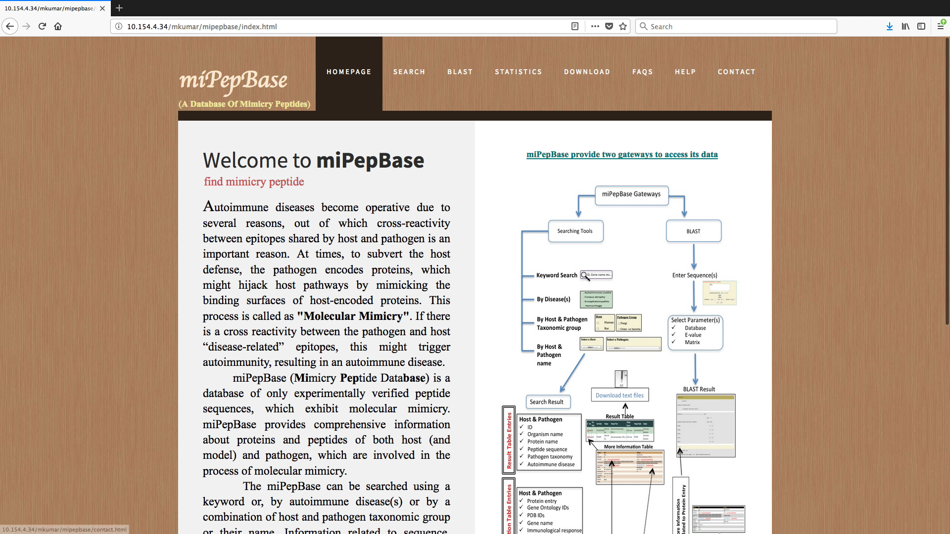
Study 1: miPepBase-A database of experimentally verified peptides involved in molecular mimicry
(Garg, A., et al. miPepBase: A Database of Experimentally Verified Peptides Involved in Molecular Mimicry. Frontiers in microbiology 2017;8:2053)

Slide 10
Study 2: Using molecular mimicry-inducing pathways of pathogens as novel drug targets
The role of molecular mimicry in microbial pathogenesis has not been conducted for most of the pathogens, except for a few fragmentary studies.
For example:
-Group A Streptococcus and group B Neisseria meningitides use molecular mimicry to prevent induction of pathogen-specific immune response.
-Autoantibodies responsible for wegener's granulomatosis and systemic lupus erythematosus have been observed in nearly half of the patients suffering from tuberculosis (TB).
Analysis of differential gene expression among TB patients and patients with autoimmune or infectious diseases indicated that a combination of infection and autoimmune disease signatures could explain 96.7% of the differentially expressed TB signatures (Clayton, K., et al. (2017).

Slide 11
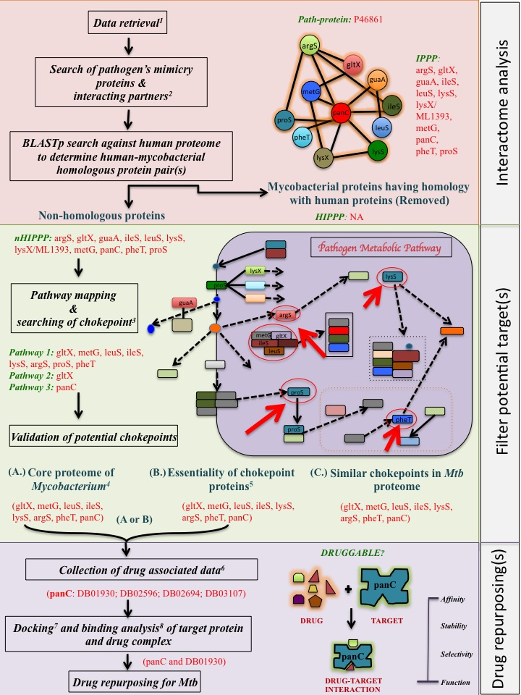
The overall schema of drug repurposing
Interactome analysis
Filter potential target(s)
Drug repurposing
(A)
(B)
(C)

Slide 12
PART - I
Interactome
Analysis
STEP:1
STEP: 2
STEP: 3
Compilation of experimentally
verified Mycobacterial proteins
Searching for interaction partners of pathogen’s proteins (IPPP)
Alternative methodology to find interacting proteins.
BLAST against UniProtKB
Data was collected from miPepBase database.
RESULT: We found 25 events, 20 distinct proteins of related to Mycobacterium spp., using “mycobacterium” keyword.
Using STRING, of the 19 path-proteins, we were able to find interacting partners for 16 proteins (scored ≥0.4. ).
BLAST at default parameters
Highest hit having interaction protein related information taken into consideration.

Slide 13

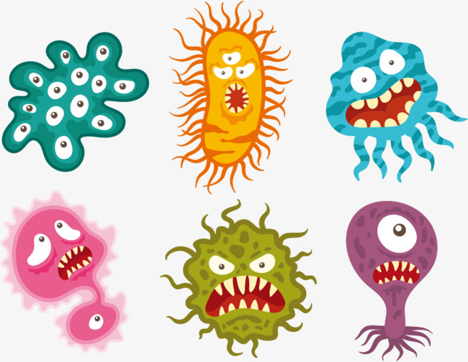
STEP: 4
Omission of homologous host (human) protein.
STRING search revealed that for the 15 path-proteins, there were 148 interacting protein partners.
If IPPP had alignment identity ≤50% with alignment coverage ≥80% with a human protein, these were considered as non-homologous IPPP (nHIPPP).
For pair wise alignment, sequence of interacting proteins and human proteome downloaded from STRING and UniProtKB database respectively.

Slide 14
PART - II
Filter potential target(s)
STEP:5
Pathway mapping and determination of chokepoints in mycobacterial metabolic pathway
To know the role of particular nHIPPP in metabolic pathway KEGG was used.
After mapping all nHIPPP in KEGG pathway, we manually surveyed all metabolic pathways to find chokepoint reaction that are being carried by nHIPPP.

Slide 15
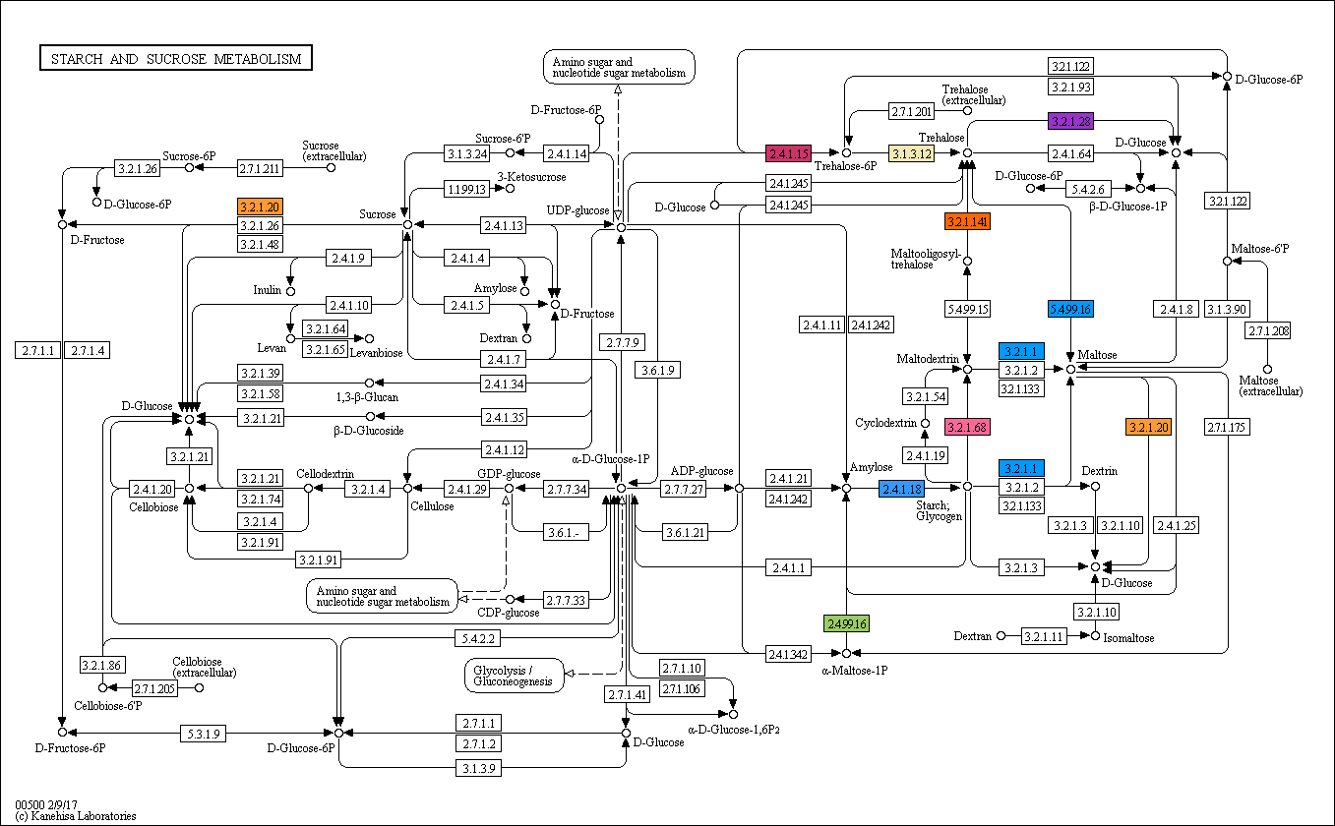
Example: P9WN15
KEGG ID: mtu00500
ostB1
ostA
ostB2
aglA
Interacting proteins | Color code
Rv2006 | #9933cc
Rv3400 | #009999
Rv3401 | #ff0000
aglA | #ff9933
glgB | #3399ff
glgE | #99cc66
glgX | #ff6699
otsA | #cc3366
otsB | #f2e9b6
treS | #0099ff
treZ | #ff6600
treZ
treS
treX
aglA
glgB
glgE

Slide 16
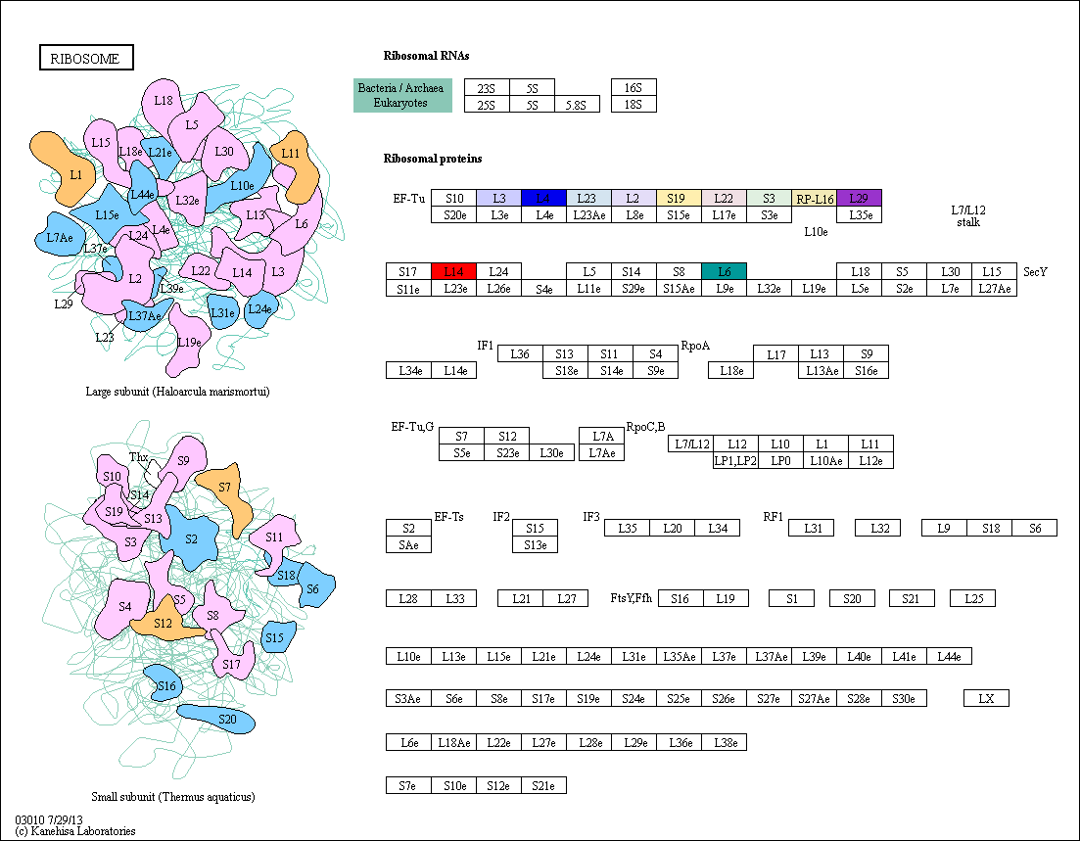
Example:
O32984
(rplP)
rplW
rpsS
rpsC
rplP (query)
rplD
rplC
rplV
rplB
rplV
rplF
rplN
-> Ribosomal subunits.
-> All interacting proteins can be used as chokepoints (except rplP).

Slide 17
PART - II
Filter potential target(s)
STEP: 6
Is chokepoints are essential proteins??
Core proteome
(b) Essential protein
Homologs of chokepoint proteins were searched in all known mycobacterial proteomes (46 mycobacterial reference proteomes were present in UniProtKB in October, 2017).
If a chokepoint protein showed ≥50% identity over 80% of sequence length in a minimum of 10 mycobacterial proteomes, it was considered as a part of the core proteome.
If a chokepoint protein was considered as essential protein if it had an alignment identity ≥50% with a protein contained in Database of Essential Genes (DEG), over 80% of sequence length.

Slide 18
PART - III
STEP: 7
Druggability of selected targets.
Drug identification
Drug optimization
Lipinski’s rule of five scales that includes molecular weight ≤500, number of rotatable bonds ≤10, hydrogen bond donors ≤5, hydrogen bond acceptors ≤10 and logP ≤5.Half-life ≥60 minutes and toxicity information.
Drug molecules which possessed a minimum 5 of the 7 parameters were considered as probable drugs.
Drug-like compounds categorized by the DrugBank as dietary supplements, micronutrients, or vitamins were excluded from the study.
DrugBank was used database to find potential drug molecules.
Download sequences of four types - targets namely, drug targets, drug enzymes, drug carriers and drug transporters.
Potential binder of homologous chokepoint proteins - ≥50% identity over 80% of the sequence length.

Slide 19
Drug optimization
Optimized
according to
Lipinski’s rule
of five scales
Toxicity Information
+
Half-life ≥60 minutes
+
Remove drug-like compounds
Many more
Potential Drug
Molecule
Potential Lead Molecule

Slide 20
PART - III
Drug Repurposing
STEP: 8
Drug-target interaction
Molecular docking was used to model the behavior of binding partners in terms of binding affinity or interaction between biomolecule and drug molecule.
PatchDock server were used for docking drug molecules.
The structures of potential drugs were taken from DrugBank.

Slide 21
Example: rpsS and DB00759
Target and Drug interacting amino acid
residues from LigPlot⁺
Pro76
Asp53
Arg55

Slide 22
PART - III
Drug Repurposing
STEP: 9
Drug repurposing for M. tuberculosis
Molecular mimicry plays an important role in primary establishment of M. tuberculosis inside the host.
Hence, if M. tuberculosis mimicry inducing proteins are blocked the pathogen can be eliminated, way-before it establishes itself inside the host.
The fifty-three chokepoints (14 of M. tuberculosis, 20 of M. leprae and 13 of M. avium subsp. paratuberculosis) homologous proteins for forty-seven chokepoint proteins were present in the proteome of M. tuberculosis.

Slide 23


Slide 24
STEP:1 (Data Collection)
STEP:2 (Searching IPPP)
STEP:3 (Searching IPPP using BLAST against UniProtKB)
STEP:4 (Omission HIPPP)
STEP: 5
STEP: 6 (a) & (b)
STEP: 7 (a) & (b)
STEP: 9
Path-memitope | Chokepoint proteins | Essential gene (DEG database) | Core proteome | Known drug from DrugBank | Drug against target proteins | Drugs follow Lipinski’s rule | Similar chokepoints in Mtb proteome
P9WPE7 | Mtu00970: thrS,pheT; mtu05152:groL2; mtu03018:groL2 | thrS, pheT, groL2 | thrS, pheT, groL2 | NA | NA | NA | thrS, pheT, groL2
Q73WP1 | mpa00910: narK3_1, narK3_2, narU, narH, narG | NA | narK3_1, narK3_2, narH, narG | narH | narH: DB04464; DB07349 | DB07349 (2,4-Dihydroxy-3,3-Dimethyl-Butyrate) | narK3_1, narK3_2, narU, narH, narG
Q741P6 | Mpa03070:MAP_1042, secD, secE, secF, secG, secY; mpa03060:MAP_1042, secD, secE, secF, secG, secY; mpa02024:MAP_1045,MAP_1042,secE,secG,secY; mpa03030:dnaG | secD, secE, secF, secG, secY, dnaG | MAP_1042, MAP_1045, dnaG, secD, secE, secF, secG, secY | NA | NA | NA | MAP_1042, MAP_1045, dnaG, secD, secE, secF, secG, secY
P9WG07 | mtu02010: pstA1,pstA2,pstB1,pstB2, pstC1,pstS1,pstS2,pstS3; mtu02020:pstS1,pstS2,pstS3; mtu05152:pstS1,pstS2,pstS3 | NA | pstA1, pstB1,pstS2, pstS3 | NA | NA | NA | pstA1, pstB1,pstS2, pstS3
Table 1. Drug target identification summary.

Slide 25
STEP:1 (Data Collection)
STEP:2 (Searching IPPP)
STEP:3 (Searching IPPP using BLAST against UniProtKB)
STEP:4 (Omission HIPPP)
STEP: 5
STEP: 6 (a) & (b)
STEP: 7 (a) & (b)
STEP: 9
Path-memitope | Chokepoint proteins | Essential gene (DEG database) | Core proteome | Known drug from DrugBank | Drug against target proteins | Drugs follow Lipinski’s rule | Similar chokepoints in Mtb proteome
A5U2C2 | mfd, uvrA, uvrB, uvrC | uvrC | mfd, uvrA, uvrB, uvrC | NA | NA | NA | mfd, uvrA, uvrB, uvrC
I6XH73 | gadB | NA | gadB | gadB | gadB: DB03553 | NA | gadB
O32984 | rplB, rplC, rplD, rplF, rplN, rplP, rplV, rplW, rpmC, rpsC, rpsS | rplB, rplC, rplD, rplF, rplN, rplP, rplW, rpmC, rpsC, rpsS | rplB, rplC, rplD, rplF, rplN, rplP, rplW, rplV rpmC, rpsC, rpsS | rpsC, rpsS | rpsC: DB00759; DB09093 rpsS: DB08185; DB00560; DB00759; DB09093 | DB08185 (2-Methylthio-N6-Isopentenyl-Adenosine-5'-Monophosphate), DB00759 (Tetracycline) | rplB, rplC, rplD, rplF, rplN, rplP, rplW, rpmC, rpsC, rpsS
P09239 | mle03018: groEL; mle05152:groEL; mle00970:pheT | groL2, pheT | groL2, pheT | NA | NA | NA | groL2, pheT
P46861 | mle00970: gltX,metG,leuS,ileS,lysS,argS,proS,pheT; mle00860:gltX; mle00410:panC | gltX, metG, leuS, ileS, lysS, argS, pheT, panC | gltX, metG, leuS, ileS, lysS, argS, pheT, panC | panC | panC: DB01930; DB02596; DB02694; DB03107 | DB01930 ((1S)-2-{[{[(2S)-2,3-Dihydroxypropyl]Oxy}(Hydroxy)Phosphoryl]Oxy}-1-[(Pentanoyloxy)Methyl]Ethyl Octanoate) | gltX, metG, leuS, ileS, lysS, argS, pheT, panC
P9WN15 | Mtu00500: glgB; mtu00052: aglA | glgB | glgB, aglA | NA | NA | -- | glgB, aglA
Table 1. Drug target identification summary.

Slide 26
Probable drug candidates
DB01930
Target: Pantothenate synthetase - pantothenate biosynthesis is essential for Mtb virulence.
Pantoate + beta-alanine Pantothenate (Vit B5)
DB07349
Target narH and L-important of Mtb survival in hypoxic lung granuloma.
DB00759 & DB08185
Target: Ribosomal protein complex-inhibit Mtb growth by binding with 30S ribosomal submit and blocking translation.
Pantothenate
Synthetase

Slide 27
Prospects of the current approach
It might be useful in devising novel prophylactic/vaccination measures against TB.
It can be used as a follow up remedy after a patient is cured from TB. The drug molecules identified in our current study would disrupt the growth of latent bacteria residing inside the host, which will ultimately lead to clearance of TB bacilli from host.
The use of a drug does not involve the use of a TNF-blocker and can lead to significant improvement in treatment of pathogen induced auto-immunity.

Slide 28








Acknowledgement
Gratitude to:
Prof. Subhendu Ghosh (HOD)
Dr. Manisha Goel
Dr. Y.P .Khasha (Advisory committee)
Dr. Jagreet Kaur (Advisory committee)
Rajan Shrivastava
Shikha Srivastava
T. Daniel Tuikhang Koren
Shumaila Iqbal Siddiqui
Bhanu Sharma
Sandipan Talukdar
Spandan Kumar
Dr. Chetan Malik
Shobha Kumari
Vedvrat verma
Vineeta Kaushik
Anchal deshwal
Dr. Archna Rai
Dr. Saumya Prasad
Dr. Shikha Chandna
Mr. Promod Kmmar (Lab Staff)
Me
Vandana Chaurasia
Dr. Manish Kumar
(Ph.D. Supervisor)
Deeksha Pandey
Manisha Aswal
Dr. Ravindra Kumar
(Ph.D. 2011-16)
Sohni Singh Jain
(M.phil. 2011-12)
Dr. Abhishikha Srivastava
(Ph.D. 2013-18)

Slide 29


Slide 30
Table 1: List of Mycobacteria mimicry protein that involved in autoimmune diseases (source: miPepBase database).

Slide 31
*Obsolete entry.

Slide 32
Table 2: Data availability in STRING database.
Pathogenic Proteins | Cross-reference (STRING) | UniProtKB BLAST hit (cross-reference, STRING), % Identity | Pathogenic Protein | Interacting proteins
A0A045I964 | NA | I6XH73 (83332.Rv3431c), 100% | I6XH73 | Rv3431c, gadB, nnr, Rv3434c, Rv3435c
A5U2C2 | 419947.MRA_1429 | F5Z390 (875328.JDM601_3772), 90.8% | A5U2C2 | MRA_1028, MRA_1424, MRA_1430, MRA_1431, MRA_1432, MRA_1648, MtubH3_010100010416, mfd, uvrA, uvrB, uvrC
A5U956 | 419947.MRA_3767 | NA | A5U956 | MRA_0226, MRA_0381, MRA_1886, MRA_3014, MRA_3766, MRA_3767, MRA_3895, ethR
A0A0E2WUC4 | NA | NA | F5Z390 | JDM601_3772, JDM601_3773, JDM601_3774
O32984 | 272631.ML1860 | NA | O32984 | rplB, rplC, rplD, rplF, rplN, rplP, rplV, rplW, rpmC, rpsC, rpsS
P0A521 | Oligomer of 14 subunits | NA | P0A521 | NA
P09239 | 272631.ML0317 | NA | P09239 | clpB, dnaJ1, dnaJ2, dnaK, groL2, groS, grpE, hrcA, htpG, mdh, pheT
P46861 | 272631.ML0233 | NA | P46861 | argS, gltX, guaA, ileS, leuS, lysS, lysX, (ML1393 ), metG, panC, pheT, proS
P9WG07 | 83332.Rv0935 | NA | P9WG07 | phoU1 (Rv3301c), phoU2 (Rv0821c), pstA1, pstA2, pstB1 or phoT (Rv0820), pstB2 or pstB (Rv0933), pstC1, pstS1, pstS2, pstS3, tcrX (Rv3765c )
P9WM57 | 83332.Rv1128c | NA | P9WM57 | Rv0184, Rv0336, Rv0515, Rv1128c, Rv1278, Rv1378c, Rv1765c, Rv2015c, Rv2100, Rv3074, Rv3776

Slide 33
Table 3: List of Non-homologous interacting protein involved in molecular mimicry.
S.No. | Pathogenic Proteins | Interacting proteins | Human Homologous proteins
1 | A5U2C2 | MRA_1028, MRA_1424, MRA_1430, MRA_1431, MRA_1432, MRA_1648, MtubH3_010100010416, mfd, uvrA, uvrB, uvrC | NA
2 | A5U956 | MRA_0226, MRA_0381, MRA_1886, MRA_3014, MRA_3766, MRA_3767, MRA_3895, ethR | NA
3 | F5Z390 | JDM601_3772, JDM601_3773, JDM601_3774 | NA
4 | I6XH73 | Rv3431c, gadB, nnr, Rv3434c, Rv3435c | NA
5 | O32984 | rplB, rplC, rplD, rplF, rplN, rplP, rplV, rplW, rpmC, rpsC, rpsS | NA
7 | P09239 | clpB, dnaJ1, dnaJ2, dnaK, groL2, groS, grpE, hrcA, htpG, mdh, pheT | dnaK, mdh
6 | P0A521 | NA | NA
8 | P46861 | argS, gltX, guaA, ileS, leuS, lysS, lysX (ML1393 ), metG, panC, pheT, proS | NA
9 | P9WG07 | phoU1 (Rv3301c ), phoU2 (Rv0821c), pstA1, pstA2, pstB1 or phoT (Rv0820 ), pstB2 or pstB (Rv0933), pstC1, pstS1, pstS2, pstS3, tcrX (Rv3765c ) | NA
10 | P9WM57 | Rv0184, Rv0336, Rv0515, Rv1128c, Rv1278, Rv1378c, Rv1765c, Rv2015c, Rv2100, Rv3074, Rv3776 | NA
11 | P9WN15 | Rv2006, Rv3400, Rv3401, aglA, glgB, glgE, glgX (Rv1564c ), otsA, otsB (Rv3372), treS, treZ | NA
12 | P9WPE7 | Rv0312, Rv2264c, dnaJ1, dnaJ2, dnaK, groL2 (Rv0440), groS, hycE, metK, pheT, thrS | dnaK,metK
13 | P9WQ90 | NA | NA
14 | Q49375 | NA | NA
15 | Q53467 | NA | NA
16 | Q73T54 | MAP_2073c, MAP_2138, MAP_2784, MAP_2925, MAP_3865c, MAP_3866c, MAP_3867c, atpA, ctpA, ctpC, nrdE | atpA
17 | Q73WP1 | MAP_0368, MAP_2102c (narK3_1), MAP_3636, MAP_3707c (narK3_2), MAP_4101c, fdhF, narG, narH, narI, narJ, narU | NA
18 | Q741P6 | MAP_1042, MAP_1045, apt, dnaG, relA, secD, secE, secF, secG, secY, tatC | NA
19 | Q745A5 | MAP_0105c, MAP_0106c, MAP_1410, MAP_2148, MAP_2752, MAP_2963c, MAP_3314c, ftsK, ogt, parB, topA | NA

Slide 34
Table 4. Chokepoint proteins list.
S.No. | Pathogenic Proteins | Interacting proteins | Human Homologous proteins | KEGG Non mapped proteins | KEGG Pathway ID | Chokepoint proteins
1 | A5U2C2 | MRA_1028, MRA_1424, MRA_1430, MRA_1431, MRA_1432, MRA_1648, MtubH3_010100010416, mfd, uvrA, uvrB, uvrC | NA | MRA_1028, MRA_1424, MRA_1430, MRA_1431, MRA_1432, MRA_1648, MtubH3_010100010416 | mtu03420 | Mfd, uvrA, uvrB, uvrC
2 | A5U956 | MRA_0226, MRA_0381, MRA_1886, MRA_3014, MRA_3766, MRA_3767, MRA_3895, ethR | NA | NA | NA | NA
3 | F5Z390 | JDM601_3772, JDM601_3773, JDM601_3774 | NA | NA | NA | NA
4 | I6XH73 | Rv3431c, gadB, nnr, Rv3434c, Rv3435c | NA | Rv3431c, nnr, Rv3434c, Rv3435c | mtu00410, mtu01100, mtu00650, mtu01120, mtu00250, mtu00430, mtu02024, mtu01110 | mtu02024: gadB
5 | O32984 | rplB, rplC, rplD, rplF, rplN, rplP, rplV, rplW, rpmC, rpsC, rpsS | NA | NA | mle03010 | rplB, rplC, rplD, rplF, rplN, rplP, rplV, rplW, rpmC, rpsC, rpsS
7 | P09239 | clpB, dnaJ1, dnaJ2, dnaK, groL2, groS, grpE, hrcA, htpG, mdh, pheT | dnaK, mdh | clpB, dnaJ1, dnaJ2 , groS, grpE, hrcA, htpG | mle03018, mle05152, mle00970 | mle03018:groEL; mle05152:groEL; mle00970:pheT
6 | P0A521 | NA | NA | NA | NA | NA
8 | P46861 | argS, gltX, guaA, ileS, leuS, lysS, lysX (ML1393 ), metG, panC, pheT, proS | NA | NA | mle00970, mle01100, mle01110, mle00770, mle00230, mle00860, mle00450, mle00410, mle01120 | mle00970:gltX,metG,leuS,ileS,lysS,argS,proS,pheT; mle00860:gltX; mle00410:panC
9 | P9WG07 | phoU1 (Rv3301c ), phoU2 (Rv0821c), pstA1, pstA2, pstB1 or phoT (Rv0820 ), pstB2 or pstB (Rv0933), pstC1, pstS1, pstS2, pstS3, tcrX (Rv3765c ) | NA | phoU1 (Rv3301c ), phoU2 (Rv0821c), tcrX (Rv3765c ) | mtu02010, mtu02020, mtu05152 | mtu02010:pstB1,pstB2,pstA1,pstA2,pstC1,pstS1,pstS2,pstS3; mtu02020:pstS1,pstS2,pstS3; mtu05152:pstS1,pstS2,pstS3

Slide 35
S.No. | Pathogenic Proteins | Interacting proteins | Human Homologous proteins | KEGG Non mapped proteins | KEGG Pathway ID | Chokepoint proteins
10 | P9WM57 | Rv0184, Rv0336, Rv0515, Rv1128c, Rv1278, Rv1378c, Rv1765c, Rv2015c, Rv2100, Rv3074, Rv3776 | NA | NA | NA | NA
11 | P9WN15 | Rv2006, Rv3400, Rv3401, aglA, glgB, glgE, glgX (Rv1564c ), otsA, otsB (Rv3372), treS, treZ | NA | Rv3400, Rv3401 | mtu01100, mtu00500, mtu01110, mtu00052 | Mtu00500: glgB; mtu00052: aglA
12 | P9WPE7 | Rv0312, Rv2264c, dnaJ1, dnaJ2, dnaK, groL2 (Rv0440), groS, hycE, metK, pheT, thrS | dnaK, metK | Rv0312, Rv2264c, dnaJ1, dnaJ2, groS, hycE | mtu00970, mtu05152, mtu03018 | Mtu00970: thrS,pheT; mtu05152:groL2; mtu03018:groL2
13 | P9WQ90 | NA | NA | NA | NA | NA
14 | Q49375 | NA | NA | NA | NA | NA
15 | Q53467 | NA | NA | NA | NA | NA
16 | Q73T54 | MAP_2073c, MAP_2138, MAP_2784, MAP_2925, MAP_3865c, MAP_3866c, MAP_3867c, atpA, ctpA, ctpC, nrdE | atpA | MAP_2073MAP_2138, MAP_2784, MAP_2925, MAP_3865c, MAP_3866c, MAP_3867c, ctpA, ctpC | mpa00230, mpa00240, mpa00190 | NA
17 | Q73WP1 | MAP_0368, MAP_2102c (narK3_1), MAP_3636, MAP_3707c (narK3_2), MAP_4101c, fdhF, narG, narH, narI, narJ, narU | NA | MAP_3636, MAP_4101c, fdhF | mpa00910, mpa01120, mpa02020, mpa01100, mpa00630, mpa00680, mpa01200 | mpa00910: narK3_1, narK3_2, narU, narH, narG
18 | Q741P6 | MAP_1042, MAP_1045, apt, dnaG, relA, secD, secE, secF, secG, secY, tatC | NA | NA | mpa03070, mpa03060, mpa02024, mpa00230, mpa01100, mpa03030 | Mpa03070: MAP_1042, secD, secE, secF, secG, secY; mpa03060:MAP_1042, secD, secE, secF, secG, secY; mpa02024:MAP_1045,MAP_1042,secE,secG,secY; mpa03030:dnaG
19 | Q745A5 | MAP_0105c, MAP_0106c, MAP_1410, MAP_2148, MAP_2752, MAP_2963c, MAP_3314c, ftsK, ogt, parB, topA | NA | NA | NA | NA

